Slide 1


Assessing the Spatio-Temporal Accessibility of Pharmacy Care in Vermont, USA
Sam Roubin¹, Joseph Holler¹, and Peter Kedron²
¹Department of Geography, Middlebury College
²Department of Geography, University of California Santa Barbara
AAG 2024, April 16th

Slide 2
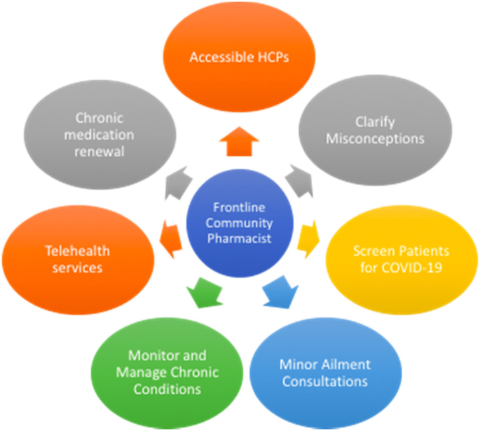
Why does access to pharmacy care matter?
Increasingly important part of primary healthcare
Valuable for reaching underserved and rural populations (San-Juan-Rodriguez et al., 2018; Berenbrok et al., 2022)
Elbeddini, A., Prabaharan, T., Almasalkhi, S. et al. Pharmacists and COVID-19. J of Pharm Policy and Pract 13, 36 (2020). https://doi.org/10.1186/s40545-020-00241-3
Notes:
In recent years, pharmacy care has become an increasingly important component of primary healthcare. And this is largely because pharmacists have transitioned beyond their traditional role in solely medicine dispensing to an increasingly clinical role focused on patient-centered care. Most recently, pharmacists across the US have played a massive part in the fight against Covid-19. This figure here on the right from a 2020 study on the role of pharmacists in the pandemic highlights that pharmacists can monitor and manage chronic conditions, clarify health misconceptions, screen patients for diseases (infectious and chronic), deliver vaccines, as well as other responsibilities. And, Evidence has also shown that pharmacists are particularly valuable for reaching underserved and rural populations, as they as are typically conveniently located in community settings, have extended operational hours, and don’t require appointments.

Slide 3
Study Purpose:
To understand how spatial access to pharmacy care varies temporally across Vermont, specifically focusing on identifying areas of the state with particularly limited access.

Slide 4
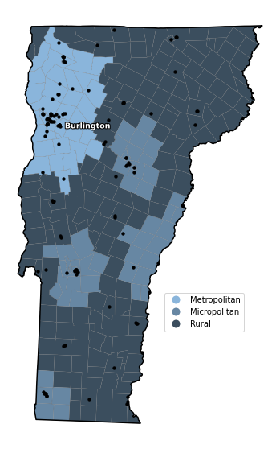
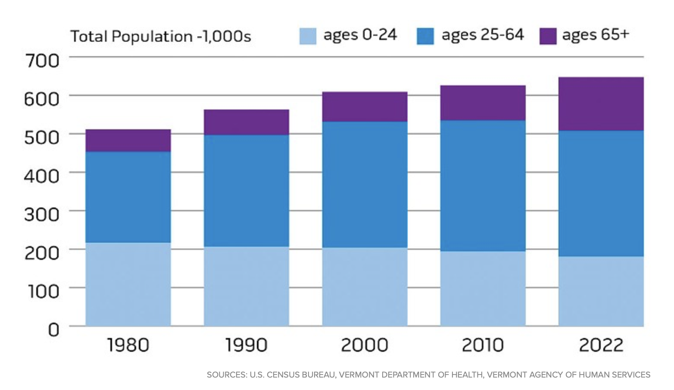
Study Area
Highly rural and aging population
255 total municipalities
35 metropolitan (1 area)
48 micropolitan (4 areas)
172 Rural
117 VT pharmacies, 75 Out-of-Sate
Figure 1. Study area with metropolitan, micropolitan, and rural
classifications for county subdivisions and pharmacy locations

Slide 5


Research Questions
1. Do certain areas of the state exhibit particularly limited access to pharmacy care during typical business hours?
2. How does the accessibility to pharmacies fluctuate across different temporal segments of the day, various days of the week, or combinations of these temporal dimensions?
3. Presuming that we have observed differences in pharmacy accessibility in rural areas, are spatial differences in access exacerbated outside of conventional business hours?

Slide 6
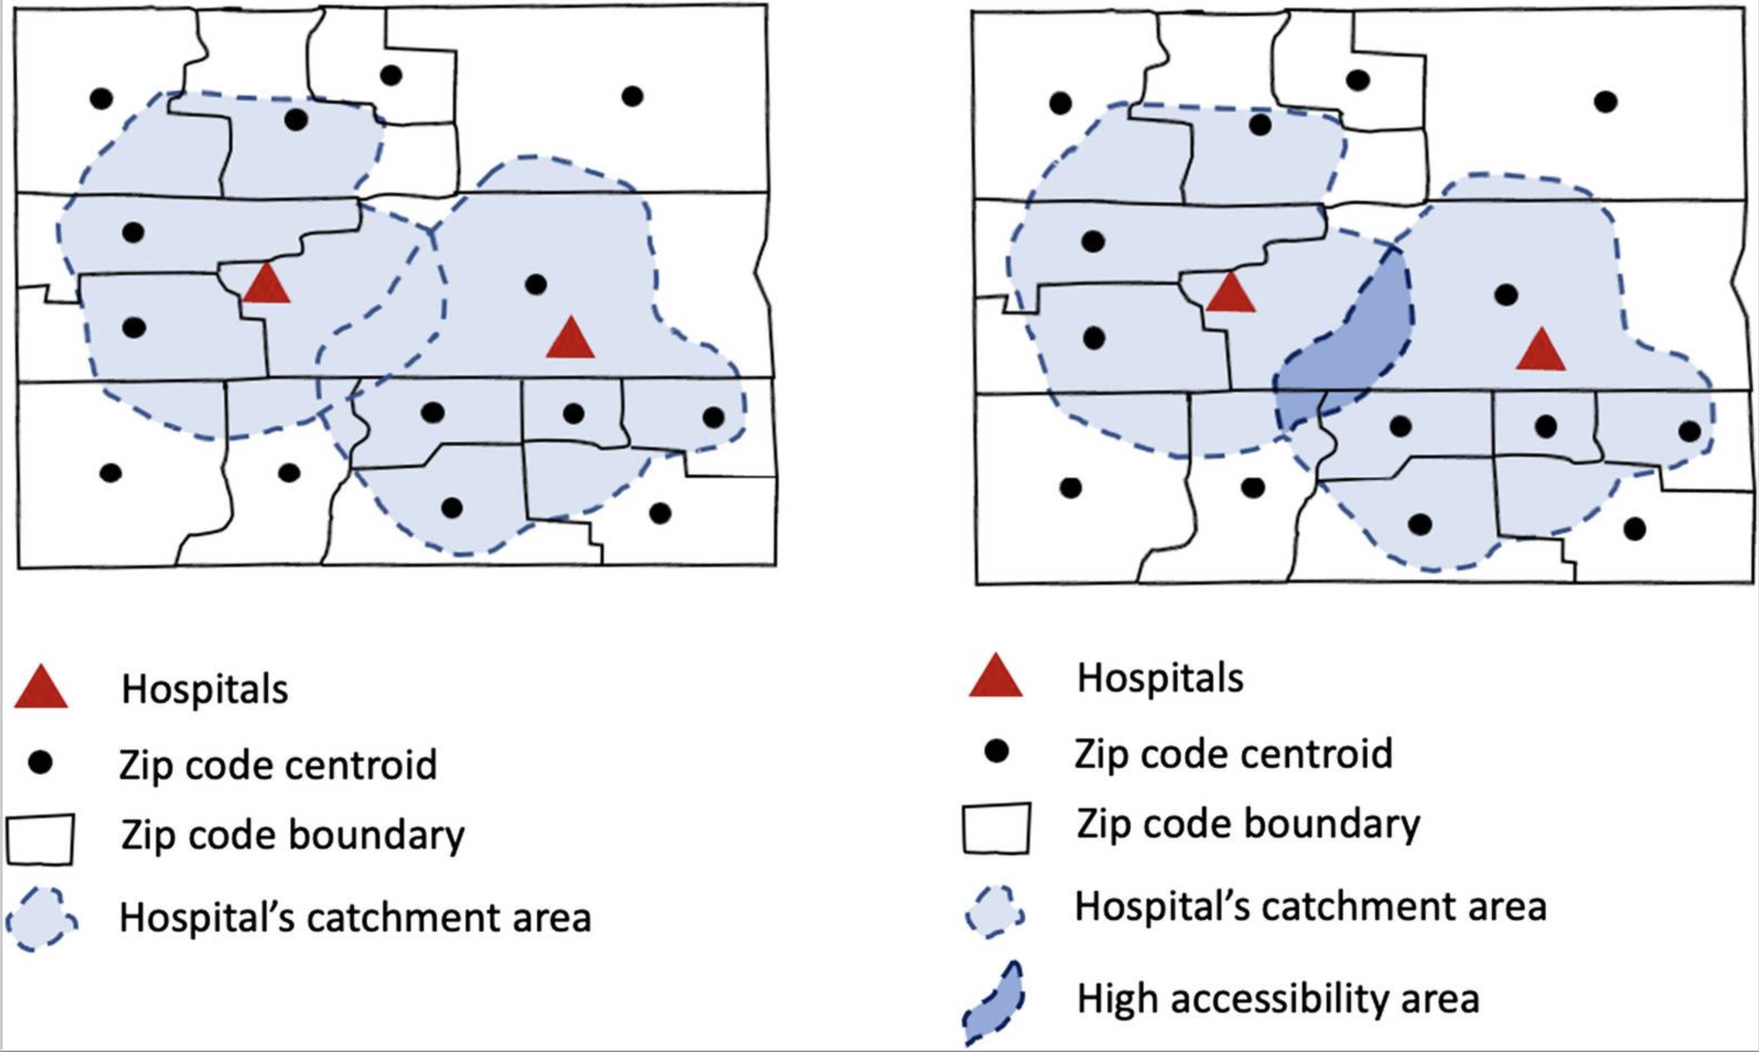
Method: E2SFCA (Enhanced 2-Step Floating Catchment Area Method)
Enhanced - 2SFCA (Luo & Qi, 2009)
Supply, Demand, Human Mobility
Step 1: Service-to-population ratios within individual service catchments
Step 2: Sum ratios within population areas
Accounts for varying distances within a catchment area
Kang et al., 2020

Slide 7
Data and Methods
Supply (Service)
Demand (Population)
Mobility
Pharmacy Staffing
(Primary Data)
Population Data
(Secondary Data)
Road Network
(Secondary Data)
Survey pharmacies in VT on staffing and hours for weekdays, Saturdays, and Sundays
Collected data for 87%
US Census Bureau ACS 2018-2022
Total pop. at town-level
Town classifications as metro, micro, or rural
OSMnX road data
Speed limit data + distances → travel times
E2SFCA
CyberGIS – Jupyter
Temporally-explicit
Town-level Accessibility Scores
(Relative values representing approximation of pharmacists available per 10,000 residents)
Notes:
This method yields relative town-level accessibility scores for each Vermont county subdivision, which represent our best approximation of the service-to-population ratios for each of these areas. The presented accessibility scores can be interpreted as the number of retail pharmacists per 10,000 people available nearby, where two technicians are equivalent to a pharmacist and ‘nearby’ is determined by the distance thresholds and weights.

Slide 8
Results

Slide 9
Question 1: Spatial Dimension of Access
Town Type | Mean Weekday Accessibility
Metropolitan | 4.20
Micropolitan | 4.25
Rural | 3.01
Some of the highest accessibility found in metro / micro regions
28% decreased access for rural towns compared to metro
Significant difference in mean access:
(H(2) = 14.2, p < 0.001)
Figure 2. Spatial accessibility during conventional weekday business hours

Slide 10
Question 2: Temporal Dimension of Access
41% and 58% decrease in mean access on Saturday and Sunday, respectively
Significant difference in mean access:
(H(2) = 202.7, p < 0.001)
Day | Mean Accessibility
Weekday | 3.41
Saturday | 2.02
Sunday | 1.43
Figure 3. Spatial accessibility maps by day of the week. Each map represents the maximum accessibility on each day (i.e. at 12 pm)

Slide 11
Question 2: Temporal Dimension of Access Cont.
Weekday
Opening
Extended hourly accessibility on weekdays – Earlier + later access
Saturday
Sunday
Closing
Figure 4. Mean spatial accessibility throughout hours of the day, broken down by days of the week.

Slide 12
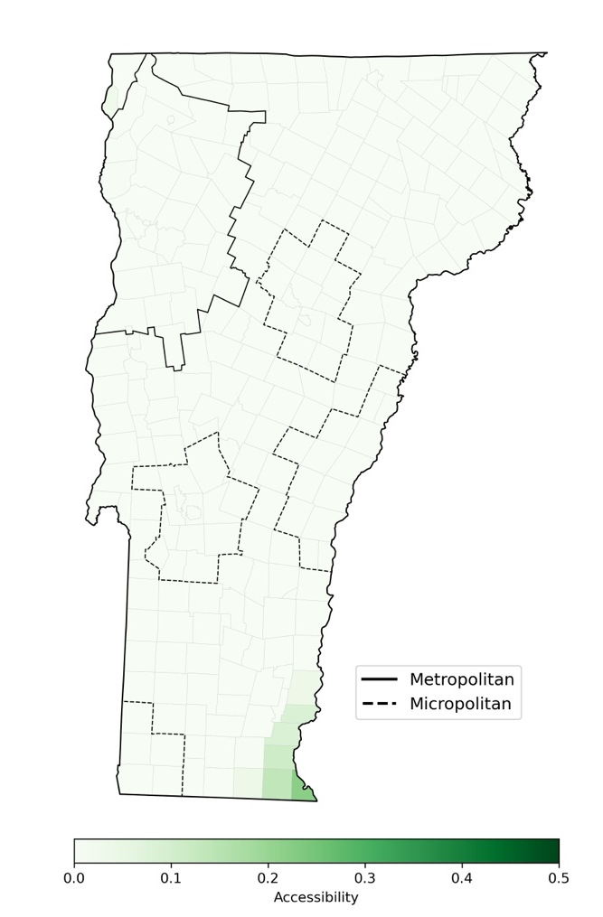
Late-Night Accessibility
24-hour pharmacies provide consistent access to essential medicines
May more significantly impact:
People with chronic conditions
Families with children
People facing emergency situations
Zero 24-hour pharmacies in Vermont
Compared to 4.9% of pharmacies nationwide (Qato et al. 2017)
Figure 5. Late night accessibility (between 10pm and 7am).
Notes:
]

Slide 13
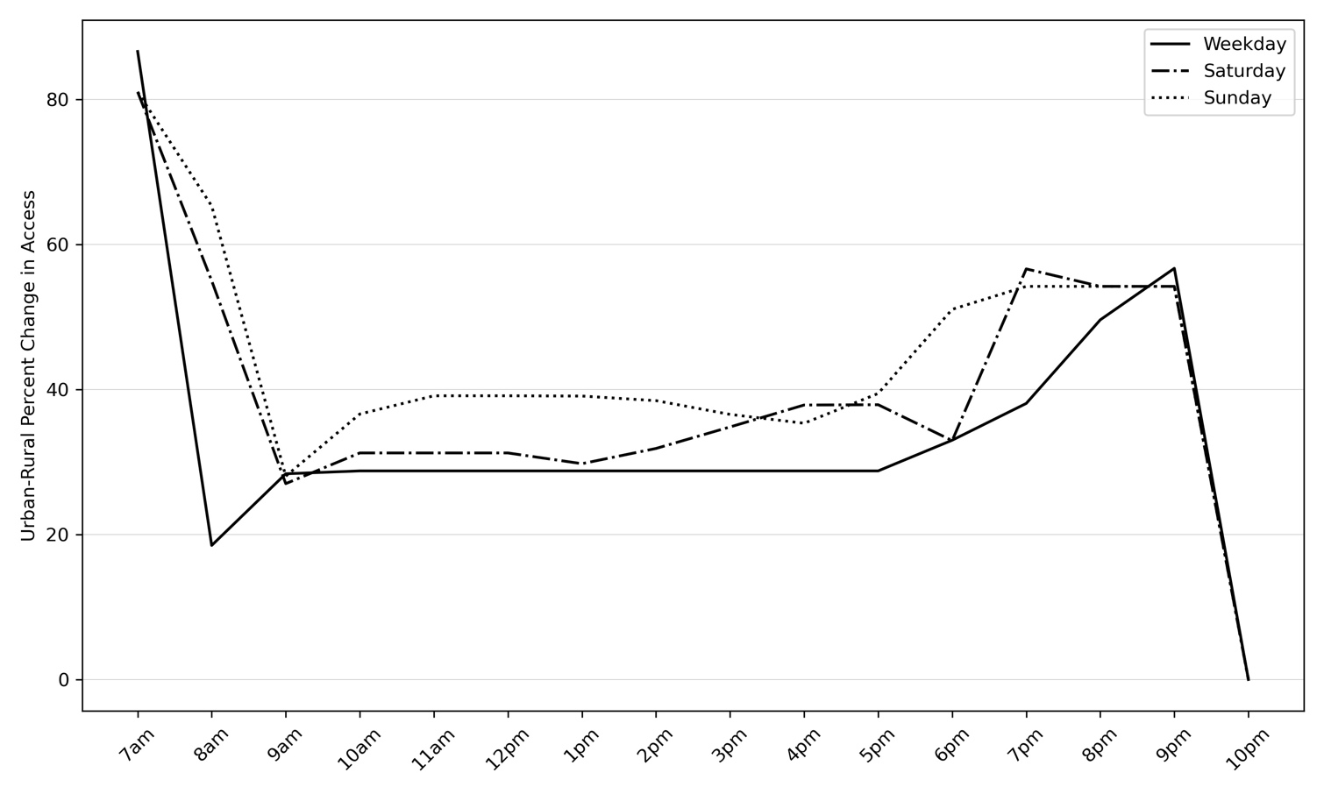
Question 3: Spatiotemporal Variation in Access
Urban-Rural accessibility differences exacerbated on Saturdays and Sundays
Also exacerbated before 9 am and after 5 pm on all days
Town Type | Mean Weekday Accessibility | Mean Saturday Accessibility | Mean Sunday Accessibility
Non-Rural | 4.23 | 2.56 | 1.95
Rural | 3.01 | 41.76 | 1.18
Difference | -28% | -31% | -40%
Figure 5. Percent difference in mean accessibility scores across hours of the day between rural and non-rural (metropolitan and micropolitan) towns by day of the week.
*Non-rural group created by taking a weighted average of
metropolitan and micropolitan

Slide 14
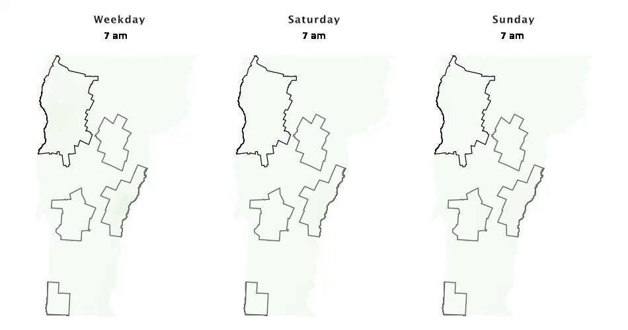
Quesition 3: Spatiotemporal Variation Cont.

Slide 15
Conclusions
1. Rural towns had lower accessibility measures to pharmacies during all temporal segments.
2. Temporal dimensions of access (particularly diminished weekend access) had a more significant impact than the rural-urban distinction on overall access to pharmacies across VT.
3. Urban-rural disparity in access was exacerbated on the weekends and at extreme hours of the day.
4. This has potentially important implications for public health planning.

Slide 16
Thank you. Questions?
sroubin@middlebury.edu , josephh@middlebury.edu

